Slide 1
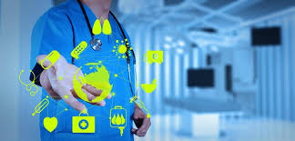
Remote Patient Monitoring
With Tele-Medicine based on Internet-of-Things

Slide 2
Contents
Abstract
Existing system
Introduction
Proposed system
Schematic of proposed system
Block diagram
Flowchart of proposed system
Conclusion
Future scope
References

Slide 3
Abstract
Internet of Things (IoT) is a system in which connected physical objects can be accessed through the internet.
Using IoT technology, various smart objects can be connected via the internet and can provide efficient data exchange methods for application purposes.
Among the large range of applications that are based on IoT, smart healthcare services play a major role.
Such a system consists of networked sensors placed on the human body that collects information regarding the patient’s health status and alerts the physician immediately during an emergency.
The privacy of each patient’s data is also highly protected.

Slide 4
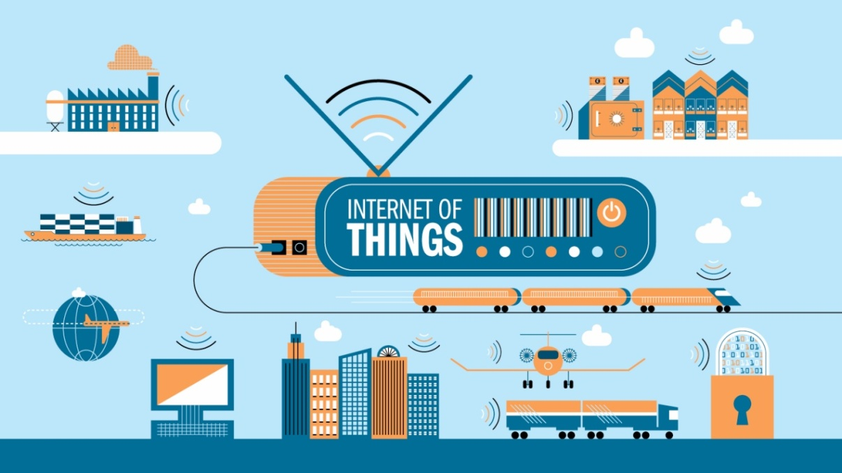
What is IoT ?
IoT is a combination of hardware and software technology that produces trillions of data by connecting multiple devices and sensors with cloud.
Anything can be IoT device, if it can transmit and receive data over the cloud and designed to process a unique task.

Slide 5
Use of Iot technology in
Medical field
IoT in healthcare is a heterogeneous computing, wirelessly communicating system of apps and devices.
It connects patients and health providers to diagnose, monitor, track and store vital statistics and medical information.
Few examples of IoT in Healthcare
Headsets that measure brainwaves.
BP monitors
Glucose monitors

Slide 6
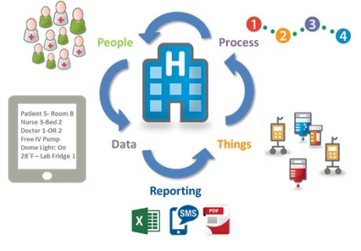
ECG monitors.
Pulse oximeter.
Sensors embedded in surgical robots and device implants.

Slide 7
Existing system
In one of the existing system the data from the sensors are not encrypted.
Another framework in which the medicines are delivered to patients by using GPS.
A similar setup is used wherein the feature of Telemedicine is incorporated in an android application.
Application also helps to take doctor’s appointment.

Slide 8
Introduction
Remote Patient Monitoring (RPM)- form of tele-health that delivers monitored data to clinical professionals from remote patients using internet.
Objective - To develop a simple and more reliable RPM.
Vital parameters of patients are monitored from anywhere in the world.
Parameters are sent to cloud that can accessed by authorized doctor.
Allows patients to maintain independence, prevent complications and minimize personal costs.
Increases the capacity of physicians to treat more patients.

Slide 9
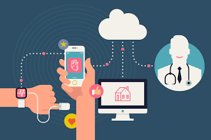
Reduced healthcare delivery costs.
Enables early detection of deterioration.
Key features:
Data security
Emergency rescue mechanism.
Tele-medicine.

Slide 10
Proposed system
The Microcontroller collects the data from the sensors and sends the data to the cloud using a web server.
The information is also sent to the LCD as well which is connected to the microcontroller.
Data can be accessed anytime by the doctors using unique IP Address and Password via any browser from any end devices such as laptop/mobile.

Slide 11
When the vital parameters cross the safe threshold, to alert the doctor a message is sent to the doctor’s cell phone.
The doctors can suggest medications to the patient which will be sent to the patient’s phone.
Hence achieving both remote patient monitoring and Tele-medicine integrated into a single system .
If there is no response reception from the prescribed doctor within a stipulated time frame, the message is sent to the mobile of another doctor.

Slide 12
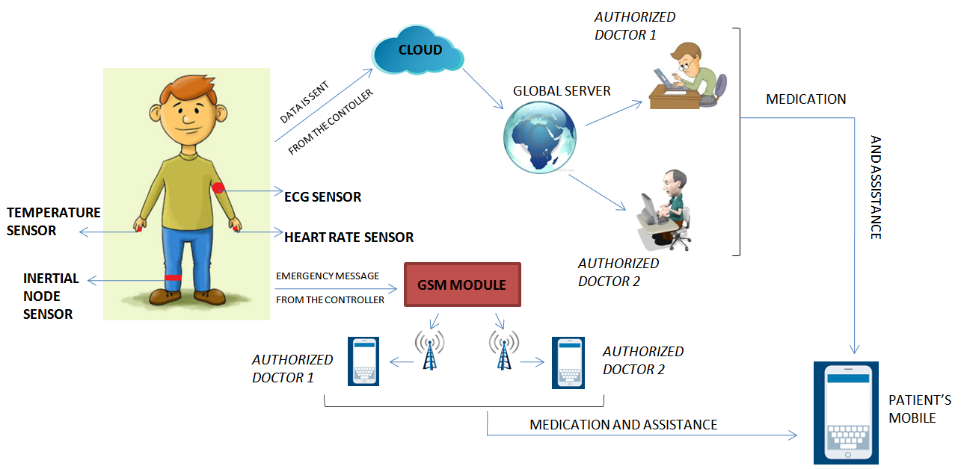
Schematic of proposed system

Slide 13
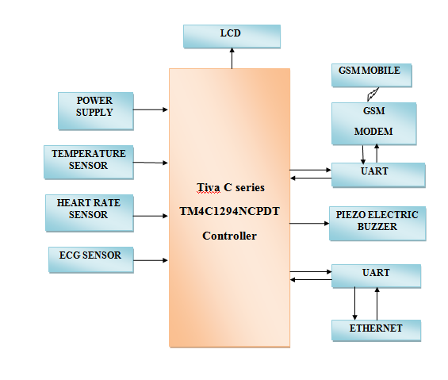
Block Diagram

Slide 14
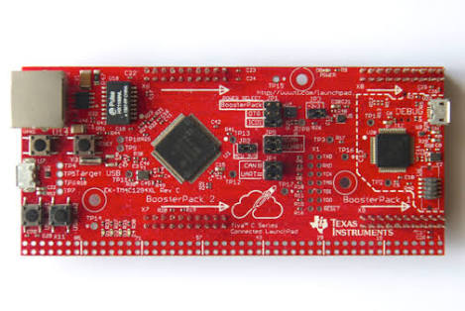
Tiva™ TM4C1294NCPDT
Microcontroller
Features:
40-pin BoosterPack connector.
USB port for power and debugging.
External debug connection.
USB micro connector.
Ethernet port
32-bit ARM Cortex-M4F architecture.
120-MHz operation.
High-performance interrupt handling.
Memory protection unit (MPU) to provide a privileged mode for protected OS functionality.

Slide 15
Temperature sensor
The sensor is a precision integrated-circuit temperature device.
Output voltage linearly proportional to the Centigrade temperature.
Provides typical accuracies of ±¼°C at room temperature.
The low-output impedance, linear output, and precise inherent calibration makes interfacing easier.
Sensors are rated to operate over a −55°C to 150°C temperature range.

Slide 16
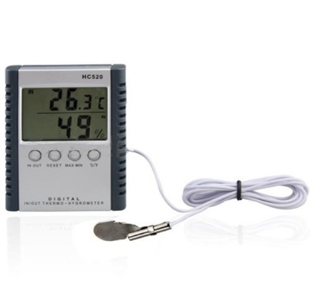
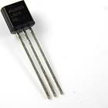
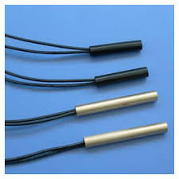
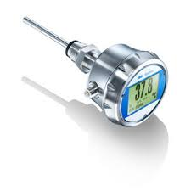
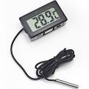
Various temperature sensors

Slide 17
Heart Rate sensor
It is a reflective optical sensor with infrared light emitter and phototransistor.
Pulling the enable pin high will turn the IR emitter LED on and activate the sensor.
Fingertip placed on the sensor will act as a reflector of the incident light.
The light reflected back from the fingertip is monitored by the phototransistor.
The output( V sensor )waveform is synchronous with heartbeat.

Slide 18
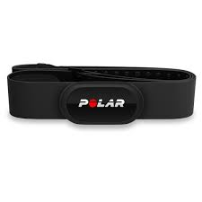
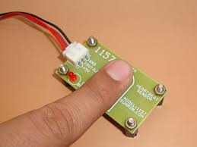
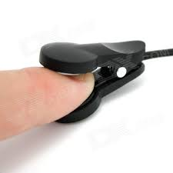
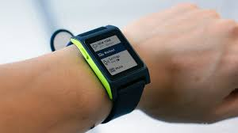
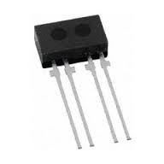
Various other Heart Rate
sensor

Slide 19
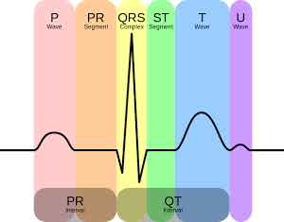
ECG sensor
It is used to measure electrical activity of the heart.
AD8232 is a signal conditioning block for ECG and other bio potential measurement applications.
ECG is separated into two basic intervals namely PR interval and QT interval.

Slide 20
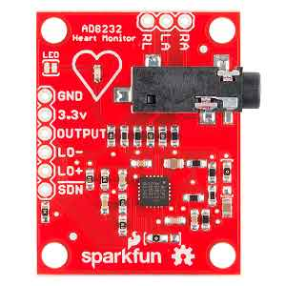

AD8232 has a operating voltage of 3.3v
This board is also provided with RA (right arm), LA(left arm), RL(right leg) pins attached.
There is also an LED indicator light that will pulsate to the rhythm of heart beat.
This board gives analog output.
AD8232

Slide 21
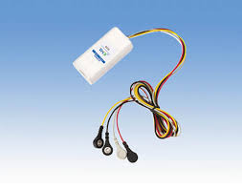
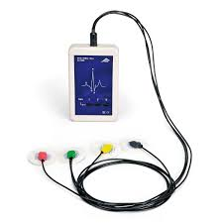
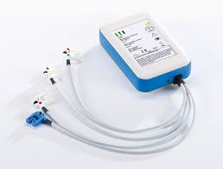
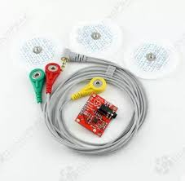
Various ECG sensors

Slide 22
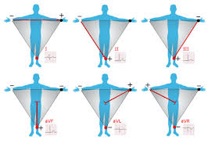
Placement of electrodes
on to the human body

Slide 23
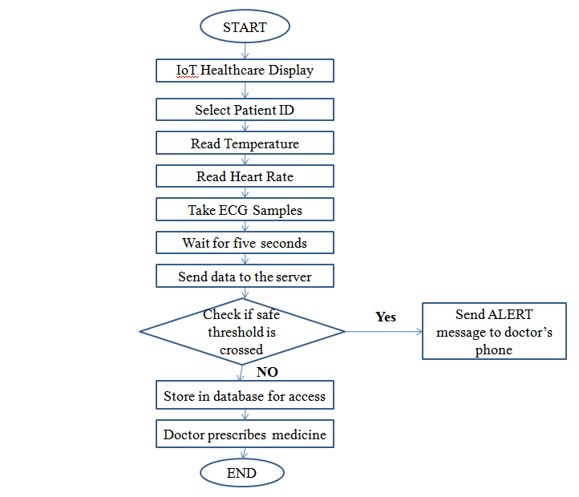
Flowchart of proposed system

Slide 24
Future Scope
Miniature wearable sensors.
Assistance to the elderly and chronic patients.
Patient tracking module can be included in the system using GPS.
A network on a diabetic patient could auto inject insulin though a pump, as soon as his insulin level declines, thus making the patient ‘doctor-free’ and virtually healthy.

Slide 25
Conclusion
A productive remote patient monitoring system is put forward which communicates through the internet to provide more desirable healthcare facilities.
The system is user friendly and in case of an emergency a warning message can be sent to the physician’s phone.
The doctors can view the patient’s parameters by logging to the web page with a unique ID and password.
Thus such a system will indeed be a boon for both doctors as well as patients.

Slide 26
References
“Health Monitoring and Management Using Internet-of-Things(IoT) Sensing with Cloud-based Processing: Oppurtunities and Challenges,” 2015 IEEE DOI 10.1109/SCC.2015.47.
“Smart Health Care System Using Internet of Things,” Journal of Network Communications and Emerging Technologies (JNCET) Volume 6, Issue 3, March (2016).
“A Modern Health Care System Using IoT and Android,” International Journal on Computer Science and Engineering (IJCSE) Vol.8 No.4 April 2016.

Slide 27

Thank You

